Slide 1
Getting Started with Linux on the Pi
Yao-Tung Tsou

Slide 2
Linux on the Pi
Raspberry Pi uses Linux as its standard operating system.
Linux has come a long way since it was first introduced.
user friendly.
Ubuntu, Mint, Debian, which are visually

Slide 3
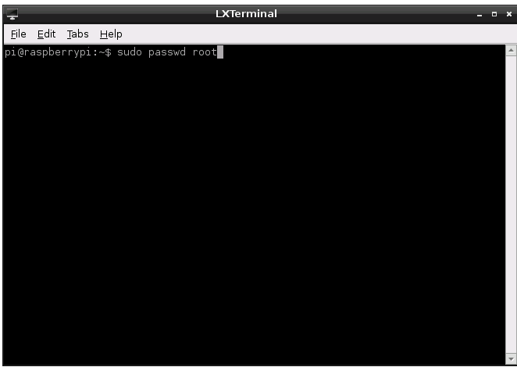
Linux on the Pi
Command-line interface (CLI): doing a lot of work with the terminal

Slide 4
Common Linux CLI
Command | Meaning
ls | List file in current directory
cd | Change directory
pwd | Print working directory
rm [filename] | Remove [filename]
mkdir [directoryname] | Make directory with [directoryname]
rmdir [directoryname] | Remove empty directory
cat [textfile] | Display contents of [textfile] in the terminal
mv [oldfile] [newfile] | Move (rename) [oldfile] to [newfile]
cp [oldfile] [newfile] | Copy [oldfile] to [newfile]
man [command] | Display manual of [command]
date | Read system date/time
echo | Echo what is typed back in the terminal
grep | Search program that uses regular expressions
sudo | Perform as root user
./[program] | Run [program]
exit | Quit terminal session

Slide 5
CLI - ls
List the files in whatever directory you happen to be in; using flags like –l and –a includes information such as file permissions and modification dates.
When you use the –l flag, the first part of every entry shows as like this: drwxr-xr-x
Using –a，lists all the files, including the “hidden” files (those whose names begin with a period (.) or a double period (..))
ls –F, lists the current files in the directory, but with a “/” after all the contents that are themselves a directory.

Slide 6
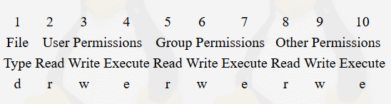
File Rights
No rights
Rights: read, write, execute
capacity (byte)
directory name
modified date
directory
user
group
others
number of link node

Slide 7
Change File Rights
Rights score table: r: 4, w: 2, x: 1, -:0
rwxr-xr-x: 755
Change to 777
$chmod 777 Desktop

Slide 8
CLI - cd
This command takes you to the directory you named, just as you would assume.
cd ~, which takes you to your home directory
cd ../, which takes you up one directory I the folder structure
If you simply type cd and press Enter, you’ll be taken back to your home directory, no matter where you are.

Slide 9
CLI - pwd
When you are lost, pwd simply tells you what directory you are in, with the answer given as the path from the root directory.
/users/wdonat/desktop/myapplication/bin/samples/linux/bin
pi@raspberrypi /bin $
You don’t know exactly where you are
Notes:
Print working directory

Slide 10
CLI - rm
Using the command rm is like dragging a file into the trash, with one important difference: for all intents and purposes, you can’t undo it, so be sure you really want to delete that file.

Slide 11
CLI – mkdir and rmdir
The commands mkdir and rmdir create and delete directories.
The caveat with rmdir is that the directory must be empty or the operating system will not allow you to remove it.
Using the –p option with rmdir, you can remove a folder’s (also empty) parent folders.
rmdir –p /foo/bar/this_directory, will delete this_directory/, bar/, and foo/, in that order.

Slide 12
CLI - cat
Using cat is a fast way to preview a file, like a text file, without actually opening it in a text editor.
If you want to preview the file line by line rather than outputting the entire file at once into your terminal, use the more command. This fill the screen with the first batch of text, and pressing the Enter key will advance through the file, one line at a time.

Slide 13
CLI – mv and cp
The commands mv and cp, while fairly straightforward, can take some getting used to.
mv doesn’t move file so much as it rename it while destroying the old file in the process.
mv myfile.txt myfile2.txt, will rename myfile.txt to myfile2.txt.
mv myfile.txt ../myotherfiles/myfiles2.txt

Slide 14
CLI – man command
This is the most important command.
If you are unsure of what a particular command does or what parameters/flags it uses, typing man [command] into your terminal brings up the linux manual page with all of the information you’d ever want to know.
While you are in the manual view, just press Enter to scroll, and press q to return to the terminal.

Slide 15
CLI - date
Using date (without an argument) simply prints the system’s date and time to the terminal. With an argument, it allows you to set that date and time.

Slide 16
CLI - echo
This command merely echoes what you type back to you in the terminal.
When you write shell scripts (prescripted sets of commands that are run in the terminal), it is similar to a computer programming language’s print statement.

Slide 17
CLI - grep
grep is a search program that can search files and directories, using whatever input you give it in the form of regular expressions, and “pipe” that output to the screen or to another file.
grep ^a.ple fruitlist.txt, will search fruitlist.txt for all lines that begin with an “a,” followed a single character, followed by “ple” and print those results to the screen. Using the “|” or pipe, allows you to send those results to different output, such as a text file.

Slide 18
CLI - sudo
sudo stands for super user do, and it simply tells the system to execute the command as if you were the root user. The system will ask for the root password and then execute the command.

Slide 19
CLI - ./program
This command to run an executable file is pretty simple.
Note that this works only on files that are executable, by your user name; it’ll give you an error if the file doesn’t have the correct permissions or simply isn’t an executable file.

Slide 20
CLI - exit
The final important command is simply exit—this stops whatever job is running in the terminal (also called a shell) and closes the terminal itself.

Slide 21
Shells in Linux
Shells in Linux have names like the Bourne shell, the C shell, and the Korn shell.
A shell is simply a text-based interface between the user and the operating system, allowing the user to execute commands directly to the file system.
The Bourne-again shell, also referred to as bash, was written as a replacement for the Bourne shell and is the default on most Linux flavors, including the Pi’s Raspbian.

Slide 22
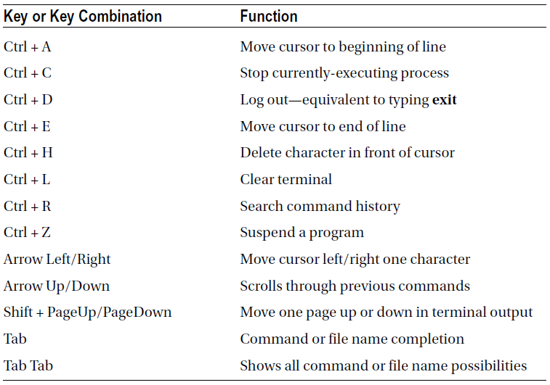
Bash Keyboard Shortcuts

Slide 23
Packet Managers
When you need to install a program from an online source in Windows, you normally download an .exe or .msi file, double-click it, and follow the instructions to install the program.
Similarly, if you’re using a Mac, you download a .dmg file and either copy the extracted file onto your hard drive or use the included installation package.

Slide 24
Packet Managers
Linux keeps track of its software using a package-management system, or package manager.
The package manager is used to download, install, upgrade, configure, and remove programs for the operating system.
Raspberry Pi uses the aptitude package manager, and you’ll probably do most of your work with it in the terminal.

Slide 25
Packet Managers
The common command to use to install a piece of software is
sudo apt-get install [package name]
You may run into problems when you request a piece of software not included in your installed repositories, but even this is normally an easy fix. If this should happen, just type
sudo add-apt repository [repository name]
When that’s done, type
sudo apt-get update
To let your package manager know about the new repository, and then type
sudo apt-get install [package name]
Notes:
apt-get: Advanced Package Tool – get
ftp://www.tmes.mlc.edu.tw/chaper8.pdf
update是更新的意思，主要是为原有的东西增加新功能，或者对已有的部分做出更改等。比如，有人告诉你他换了新手机号码，你在你的手机上删掉了原有的号码并换成新的号码，那么就是update，而不能用upgrade
upgrade是升级的意思，是指从较低级版本升级到高级的版本，这种升级往往伴有新功能的增加，因此也有update的意思。但是，如果是给予某人升职、坐飞机时的升舱等，只能用upgrade，而不能用update。

Slide 26
Text Editors
Vim is a modal editor.
It has two modes: insert and normal.
In insert mode, your keystrokes become part of the document.
Normal mode is used to control the editing session. For example, if you type an “i” while in normal mode, it switches you to insert mode. If you then type an “i” again, an “i” will be placed at the cursor’s position, exactly as you would expect a text editor to operate. By switching back and forth between these two modes, you create and edit your document.

Slide 27
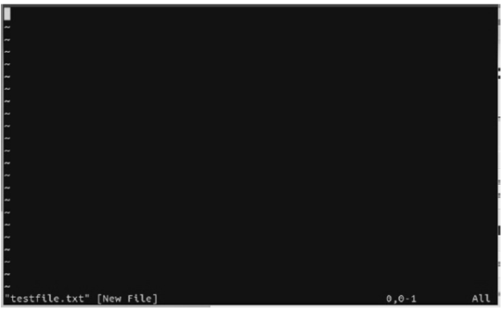
Using Vim
vim textfile.txt
Vim opens in Normal mode, meaning that you cannot edit the file right away.
To do so, you must enter Insert mode by typing “i.” The word “INSERT” will appear at the bottom left—a handy way of reminding you whether you’re in Insert or Normal mode.
When you’re done typing, press the Esc key to return to Normal mode.
In Normal mode, you can move around the document with the arrow keys, just as you can in Insert mode, but you can’t change or add anything until you type “i.”

Slide 28
Using Vim
vim textfile.txt
To save a file, make sure you’re in Normal mode by pressing the Esc key at least once. Then type “:w” (without the quotes) and press Enter. To save and exit at the same time, type “:x”(again, without quotes) and press Enter. Obviously, if you’re in Insert mode when you type these characters, all you’ll succeed in doing is adding :w or :x to your document.

Slide 29
Text Editors
Emacs, on the other hand, has a more intuitive interface.
You can move throughout the document using the arrow keys, and when you press a key, you can expect it to appear wherever the cursor happens to be.
Special commands, like copy/paste, save, and so forth are called by pressing the Control key, followed by a sequence of others, usually starting with the “x.” So, for instance, if you wanted to save the current document, you would press Ctrl-x, then Ctrl-s, highlighted in the emacs menu as C-x C-s.

Slide 30

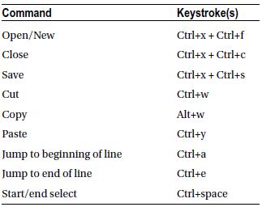
Using Emacs
emacs textfile.txt
You can start typing immediately.

Slide 31
Text Editors
Nano, on the other hand, is more intuitive than both of the others.
You enter text as you would in any other editor, and the commands you use are always shown at the bottom of the screen.

Slide 32
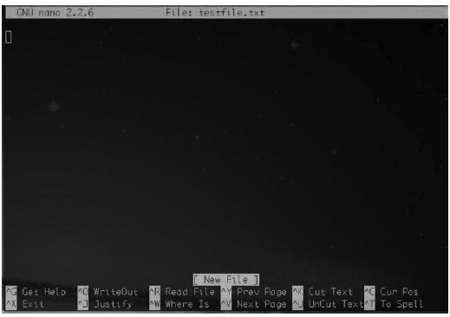
Using nano
nano textfile.txt
Common commands are listed at the bottom, with the caret character (^) signifying the Ctrl key.
To save a file, type Ctrl+X to exit. You’ll be asked if you want to save the file, and under what name. In general, type “Y” and then Enter to save the file you’ve opened or created.

Slide 33
End

